Slide 1
Community Services Dhara 2013-14
(1) Dt. 05 – 07 – 2013(Strength 500 Student) Ph 2247709
Lecture on Self Development Activities
by Vanitaben Gajjar
(2) Dt. 09-07-2013 (Strength 500 Student) Ph 2247709
Blood Donation Camp
(3) Dt. 19-07-2013(Strength 500 Student) Ph 2247709
Slogan Reading on the Population Day

Slide 2
(4) Dt. 08-08-2013 (Strength 500 Student) Ph 2247709
Exhibition
(5) Dt. 16 – 08 - 2013(Strength 500 Student) Ph 2247709
Lecture on Jewelry Making
by Krishnaben Joshi
(6) Dt. 13 – 09 - 2013(Strength 500 Student) Ph 2247709
Discussion on Creation of Self Confidence

Slide 3
(7) Dt. 03 – 01 - 2014(Strength 500 Student) Ph 2247709
Lecture on Importance of Physical Education for Physical and Mental Development
by Haribhai Kagathara
(8) Dt. 10 – 01 - 2014(Strength 500 Student) Ph 2247709
College Campus Cleaning Programme

Slide 4
(9) Dt. 17 – 01 - 2014(Strength 500 Student) Ph 2247709
Evacuation Competition under UGC Diamond Jubilee
Sub:1 Swami Vivekanands Views on Education
2 Swami Vivekanands Views on Women Progress
3 Outstanding Women of India

Slide 5
Winner: First Niyati Dalal B.Com. Sem-2
Second Aksha Karatila B.Com. Sem-4
Third Hiral Raydddda B.A. Sem-2
Judges:Maheshbhai Kikani & Vipulbhai Dashini

Slide 6
(10) Dt. 31 – 01 - 2014(Strength 500 Student) Ph 2247709
Ads Show on Awareness of Voting
by Chetanbhai Dave
(11) Dt. 07 – 02 - 2014(Strength 500 Student) Ph 2247709
Exhibition

Slide 7
(12) Dt. 14 – 02 - 2014(Strength 500 Student) Ph 2247709
Lecture on Awareness about Thalesamia
by Dr. Chetanaben Bechara
(13) Dt. 22 – 02 - 2014(Strength 500 Student) Ph 2247709
General Knowledge Test

Slide 8
(14) Dt. 28 – 02 - 2014(Strength 500 Student) Ph 2247709
Lecture on Mental Stress
by Devayatbhai Baku
(15) Dt. 07 – 03 - 2014(Strength 500 Student) Ph 2247709
Presentation on Importance of Gandhiji in Modern Time
by Ms. Kajal (Student)
Blood Donation Camp

Slide 9
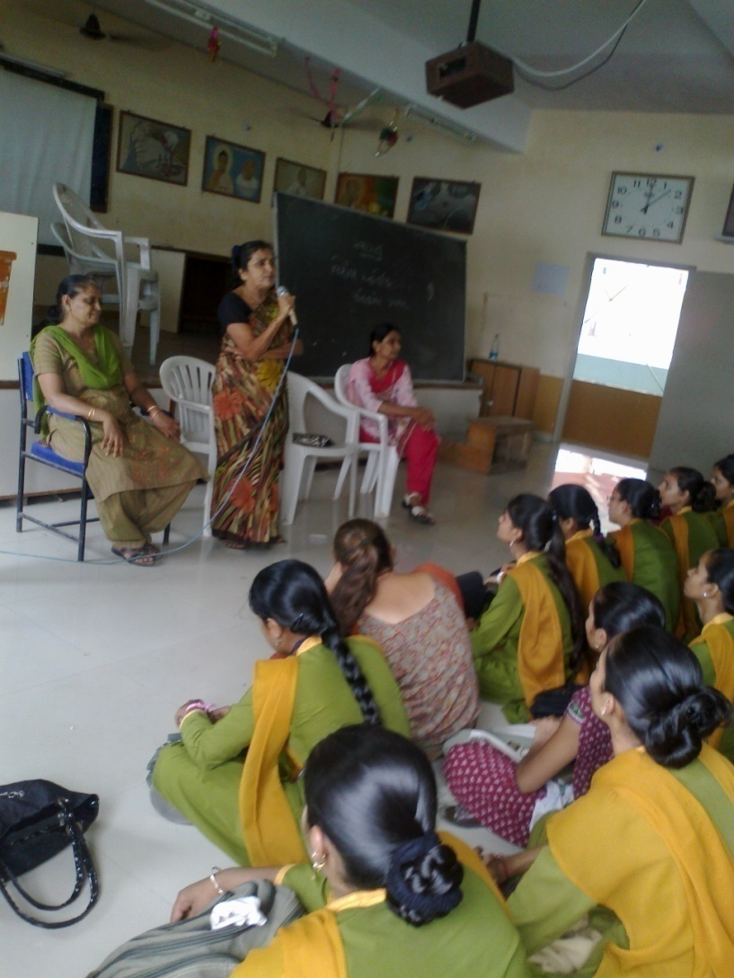
1

Slide 10
2

Slide 11
3

Slide 12
4

Slide 13
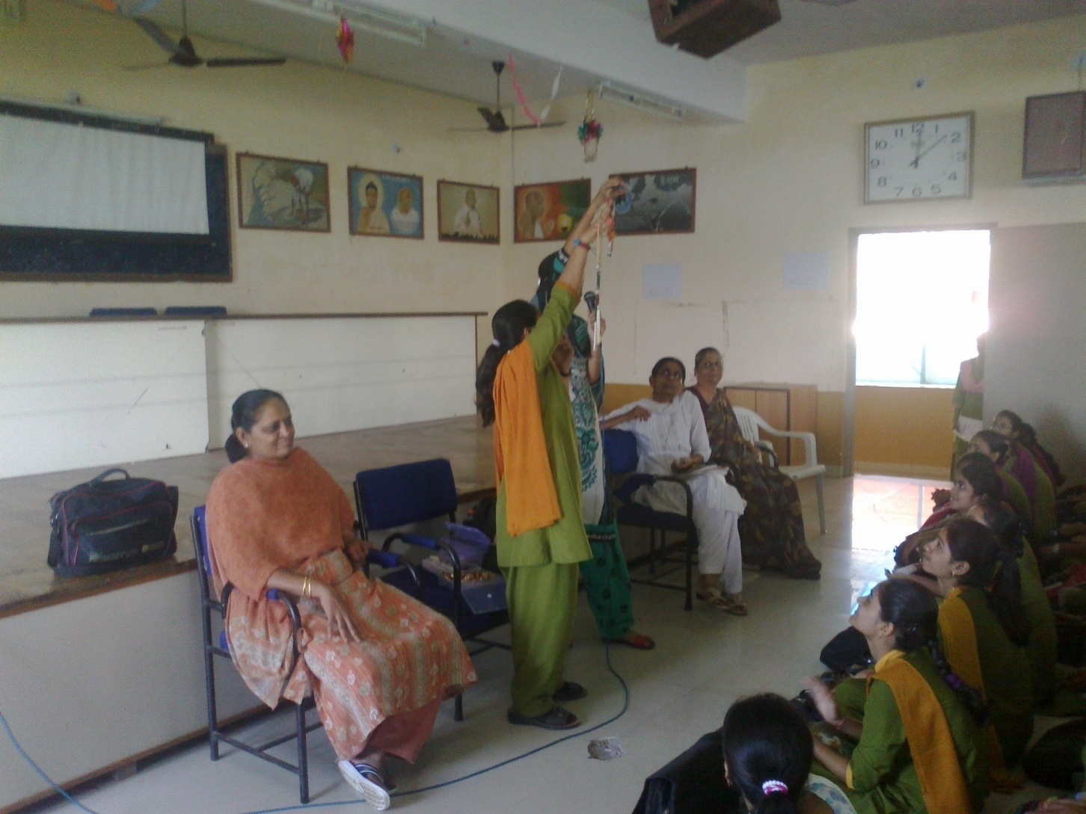
5

Slide 14
6

Slide 15
7

Slide 16
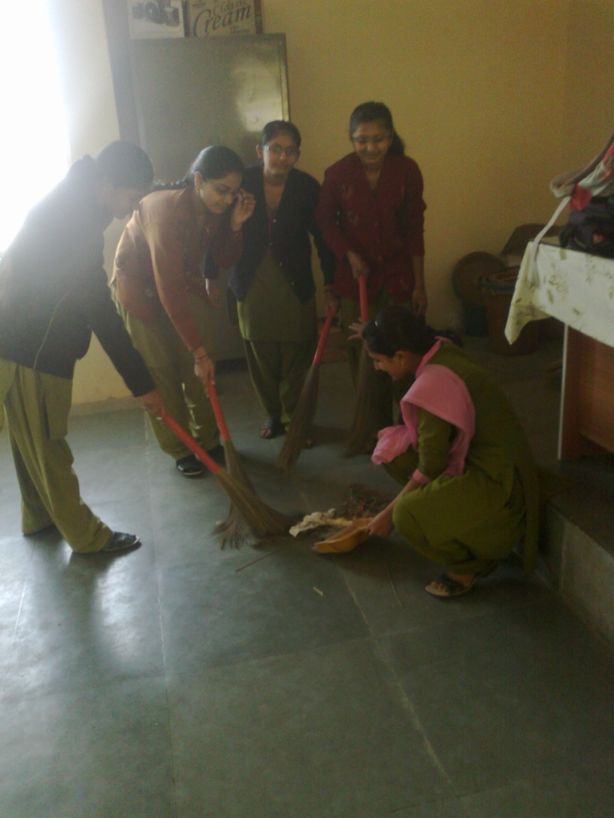
8

Slide 17
9

Slide 18
10

Slide 19
11

Slide 20
12

Slide 21
13

Slide 22
14

Slide 23
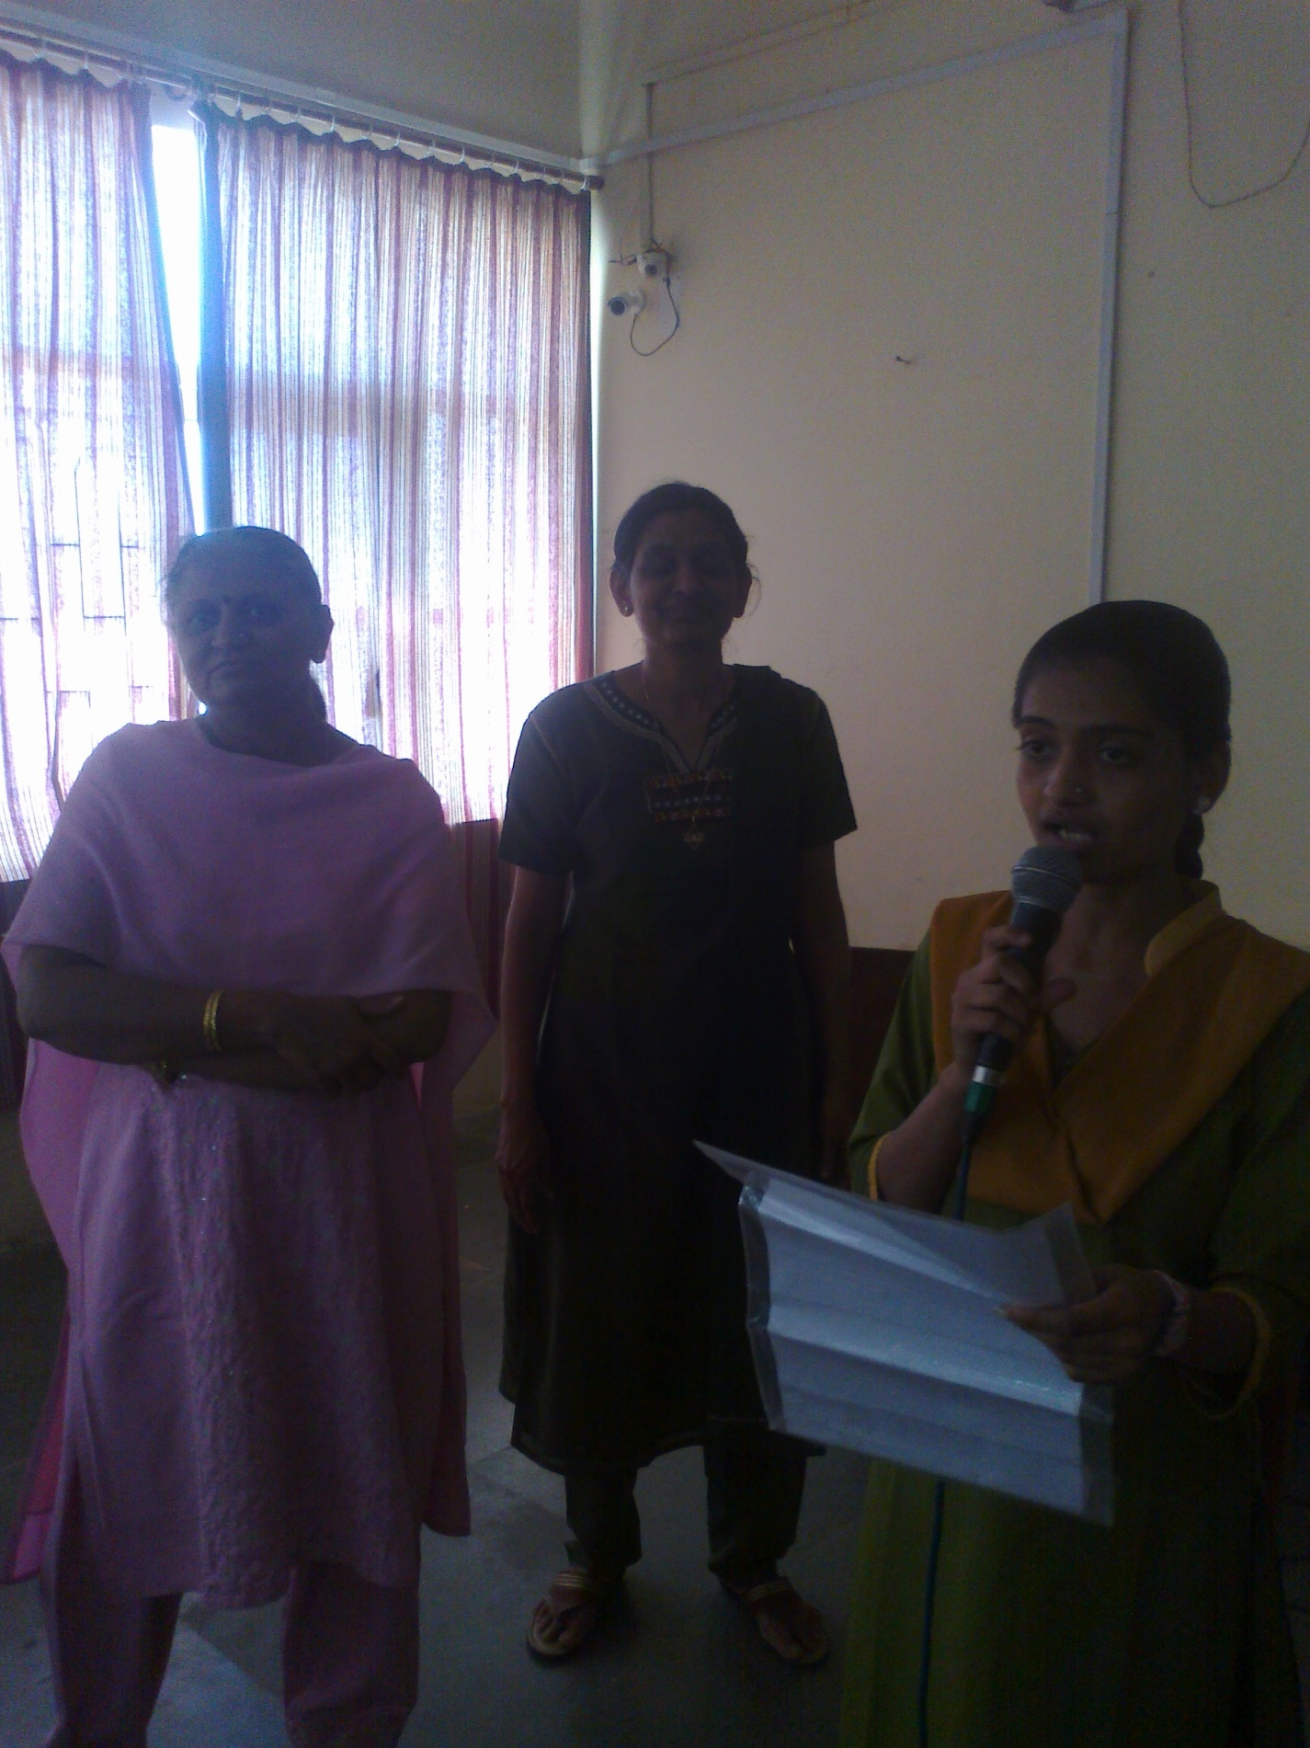
151

